Slide 1
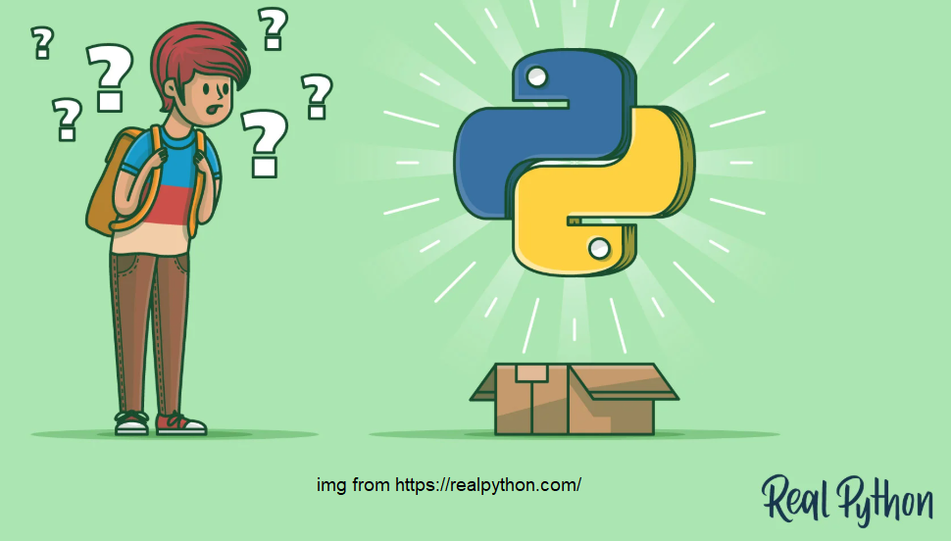
PYTHON PROGRAM ELEMENT
CHAPTER 2 (PART 1):
DFP 40203 PYTHON PROGRAMMING

Slide 2
LEARNING OUTCOMES
Explain variables and data types in Python
Apply Operators and Operators Precedence
Define and write a Conditional and Looping Statement

Slide 3

Python Syntax
Its not necessary in Python to end a command with semicolon
Indentation:
refers to the spaces at the beginning of a code line.
Where in other programming languages the indentation in code is for readability only, the indentation in Python is very important.
Python uses indentation to indicate a block of code.

Slide 4


Variable(1)
Variables are containers for storing data values.
A variable is created the moment you first assign a value to it.
Variables do not need to be declared with any particular type and can even change type after they have been set.
Output :

Slide 5

Variable(1)
The data type of a variable is automatically given to the variable based on the values assign to the variable.
Output :

Slide 6
Variable Name (1)
Must contain at least one character.
The first character of a variable must be an alphabetic letter (upper or lower case) or the underscore
The remaining characters (if any) may be alphabetic characters (upper or lower case), the underscore, or a digit
No other characters (including spaces) are permitted in identifiers.
A reserved word cannot be used as an identifier

Slide 7
Variable Name (2)
Python accepted style
my_name, your_name, user_name,
account_name,count, total_number_of_users,
percentage_passed, pass_rate,where_we_live,
house_number,is_okay, is_correct, status_flag

Slide 8
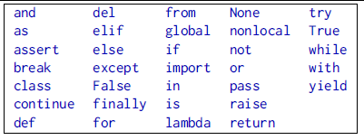
Reserve Word
The listed keyword cannot be used as variable name

Slide 9
Question 1: Identify whether the following variables is valid or not.
Home4you
after_you
$money
_thatsall
2001
All10
pass
python_101
hello pi
break

Slide 10
Data Type
Numbers
Integers
Floating point numbers.
Complex number (not covered in this course)
String
strings are defined either with a single quote or a double quotes.
Boolean
has two valies either True or False
None
Empty or Null Values
Num1=“ ” or num1=null

Slide 11




Numbers & Floating Point
Numbers
FLOAT
Output :
Output :

Slide 12
String(1)
Strings are defined either with a single quote or a double quotes or in Python 3 you can use triple quotes.
The difference between single quote and double quotes is that it it easy to include apostrophes (example : Aileen’s book)
For triple quotes, it allow strings to span multiple lines, including space, NEWLINEs, TABs, and any other special characters
Any variables created using input() method will be data type string. (To do arithmetic operation you need to convert/cast the variables)

Slide 13
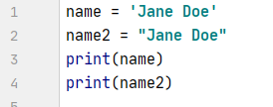






String(2)
Program | Output

Slide 14
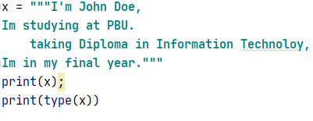
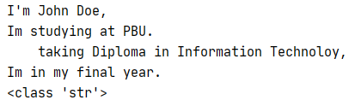

String(3)
Program | Output

Slide 15
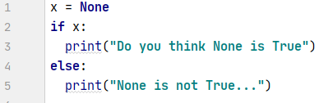

None Value
The None keyword is used to define a null value, or no value at all.
None is not the same as 0, False, or an empty string.
None is a datatype of its own (NoneType)
X = “” or X=null => X=None
Output :

Slide 16
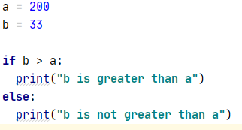
Boolean(1)
Booleans represent one of two values: True or False.
You can evaluate any expression in Python, and get one of two answers, True or False.
When you compare two values, the expression is evaluated and Python returns the Boolean answer:
print( 10 > 9 ) will return True
print(5<1) will return False
When you run a condition in an if statement, Python returns True or False:
Output :

Slide 17
The bool() function(1)
converts a value to Boolean (True or False) using the standard truth testing procedure.
bool() takes a single parameter value.
Return False if the value is omitted or false
Return True if the value is true

Slide 18
The bool() function(2)
The following values are considered false in Python:
None
False
Zero of any numeric type. For example, 0, 0.0, 0j
Empty sequence. For example, (), [], ''.
Empty mapping. For example, {}
objects of Classes which has __bool__() or __len()__ method which returns 0 or False
All other values except these values are considered true.

Slide 19
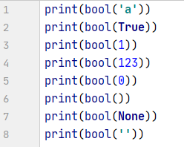
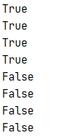
The bool()function(3)
Output :

Slide 20


Python Comment(1)
Comments can be used to :
explain Python code.
make the code more readable.
prevent execution when testing code
Comments starts with a #
Comments can be placed at the beginning or at the end of a line, and Python will ignore the rest of the line:

Slide 21
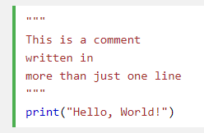
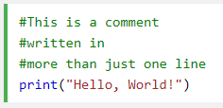
Python Comment(2)
Multi Line Comments
Python does not really have a syntax for multi line comments.
To add a multiline comment you could insert a # for each line
Or, not quite as intended, you can use a multiline string.
Since Python will ignore string literals that are not assigned to a variable, you can add a multiline string (triple quotes) in your code, and place your comment inside it:

Slide 22
Python Casting
There may be times when you want to specify a type on to a variable. This can be done with casting.
Python is an object-orientated language, and as such it uses classes to define data types, including its primitive types.
Casting in python is therefore done using constructor functions:
int() - constructs an integer number from an integer literal, a float literal (by rounding down to the previous whole number), or a string literal (providing the string represents a whole number)
float() - constructs a float number from an integer literal, a float literal or a string literal (providing the string represents a float or an integer)
str() - constructs a string from a wide variety of data types, including strings, integer literals and float literals

Slide 23
Python Operators
Operators are used to perform operations on variables and values.
Python divides the operators in the following groups:
Arithmetic operators
Assignment operators
Comparison operators
Logical operators

Slide 24
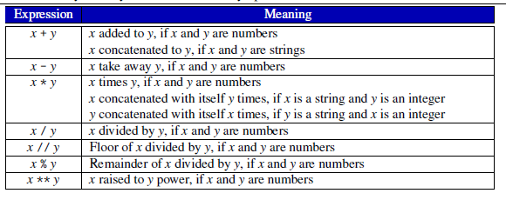
Arithmetic operators

Slide 25
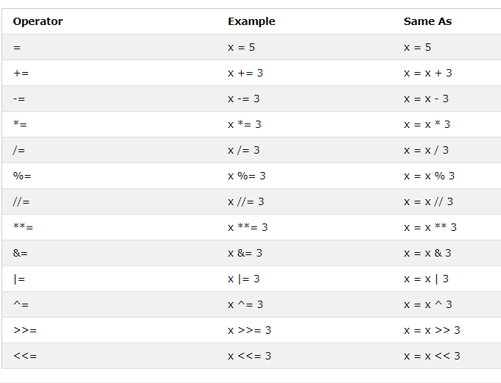
Assignment operators
Assignment operators are used to assign values to variables:

Slide 26
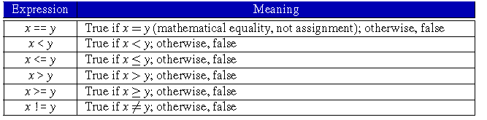
Comparison operators(1)
Comparison or relational operators are used to compare two values:

Slide 27
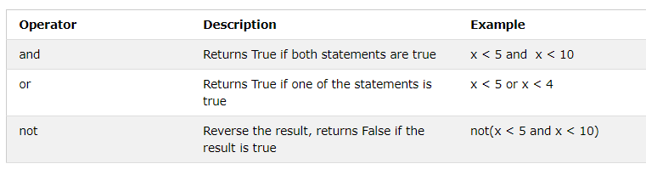
Logical operators
Logical operators are used to combine conditional statements:

Slide 28
Conditional Statement
Execution on program based on condition.
In python :
If
If.. Else
Nested if
elif
Note that the indentation in Python is very important!.

Slide 29




If statement
Program | Output

Slide 30
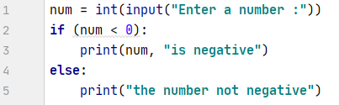


If.. Else statement
Output :
Output :

Slide 31
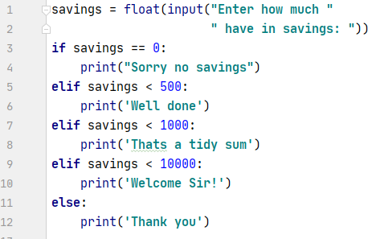


The elif statement
This else-if scenario is supported in Python by the elif element of an if statement.
Output :
Output :

Slide 32

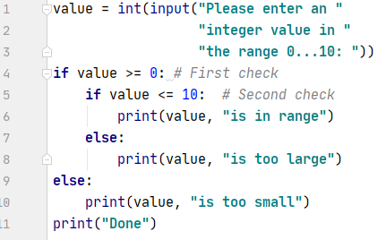


Nested if… else
Output :
Output :
Output :

Slide 33
Looping
Iteration(looping) repeats the execution of a sequence of code.
Iteration is useful for solving many programming problems. Iteration and conditional execution form the basis for algorithm construction.\
Python has two primitive loop command which are:
While Loop
For Loop
Other statement that can be use in looping
Break - stop the loop even if the while condition is true
Continue - stop the current iteration, and continue with the next

Slide 34

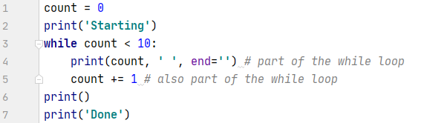

while statement(1)
With the while loop we can execute a set of statements as long as a condition is true.
Syntax :
Output :

Slide 35

for loop(1)
A for loop is used for iterating over a sequence (that is either a list, a tuple, a dictionary, a set, or a string).
To loop through a set of code a specified number of times, we can use the range() function,
The range() function returns a sequence of numbers, starting from 0 by default, and increments by 1 (by default), and ends at a specified number.
Syntax :

Slide 36


for loop
Compared to C++, Python for loop has a bit difference in syntax
C++ :
python :

Slide 37

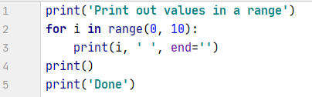
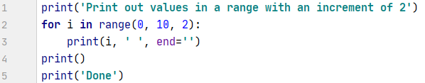


for loop(2)
Syntax :
INCREMENT BY 1 :
INCREMENT BY 2 :
Output :
Output :

Slide 38
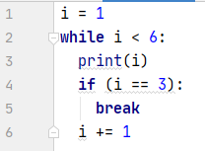

break statement
The break statement, when executed, will terminate the current loop and jump the program to the first line after the loop.
Output :

Slide 39
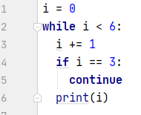

Continue Statement
The continue statement skip over part of a loop’s iteration for a particular value, but then to continue with the remaining values in the sequence.
Output :

